Slide 1
CS 3502 Operating Systems Introduction
Kun Suo
Computer Science, Kennesaw State University
https://kevinsuo.github.io/

Slide 2
Outline
Introduction & Basics
Why study Operating Systems ?
What to learn ?
Course structure
Course policy
Course goals

Slide 3
Self Introduction
Kun Suo, Ph.D.
Homepage, https://kevinsuo.github.io/
Research interests:
Cloud computing and virtualization;
Operating systems, containers and kubernetes;
Software defined network (SDN) and network function virtualization (NFV)
Big data systems and machine learning systems
Projects you may be interested in:
Several projects in Cloud & Data & Edge
https://kevinsuo.github.io/code-lab.html

Slide 4
Now it’s your turn
Name, program/year, where from
Your interests in Computer Science
What is the first OS your ever used? Current OS using? How many OSes you ever used (name them)?
https://www2.eecs.berkeley.edu/Research/Areas/CS/
If you are in the online course, introduce yourself in D2L, Discussions → Self-Introduction

Slide 5
Now it’s your turn

Slide 6
Now it’s your turn

Slide 7
Now it’s your turn

Slide 8
Now it’s your turn

Slide 9
Now it’s your turn

Slide 10
Course Information
Instructor: Dr. Kun Suo
Office: J-318
Email: ksuo@kennesaw.edu
Only reply to e-mails that are sent from KSU student email accounts and title the course number [CS3502]
Office Hours:
T/Th, 3pm-4pm
By appointment
Course Materials
Homework assignments, lecture slides, and other materials will be posted in the webpage (https://kevinsuo.github.io/teaching.html) and D2L.

Slide 11
Reference Book
“Operating Systems: Three Easy Pieces” by Remzi H. Arpaci-Dusseau and Andrea C. Arpaci-Dusseau:
Three pieces: virtualization, concurrency and persistence.
Free! (Separate PDFs for different chapters at http://pages.cs.wisc.edu/~remzi/OSTEP/
Hard copy option and single-PDF option are available for a fee.

Slide 12
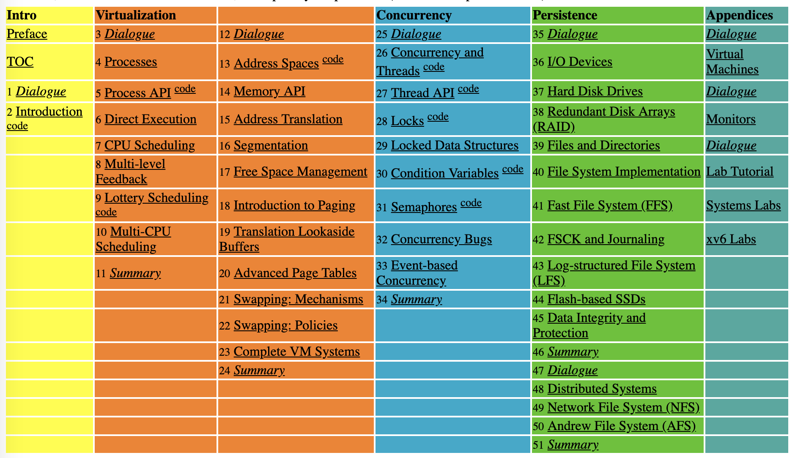
Reference Book

Slide 13
Prerequisites
Computer basics that are supposed to covered in (CS 3305) Data Structures and (CS 3503) Computer Organization and Architecture course.
C programming (code reading, kernel development and debugging). (Famous projects in C)
Linux command line environment (compiling, Makefile, debugging, simple shell programming).

Slide 14
For C and Linux beginners
C tutorial
https://www.tutorialspoint.com/cprogramming/
https://www.learn-c.org
https://www.cprogramming.com/tutorial/c-tutorial.html
Linux tutorial
https://ryanstutorials.net/linuxtutorial/
http://www.ee.surrey.ac.uk/Teaching/Unix/
https://www.tutorialspoint.com/unix/

Slide 15
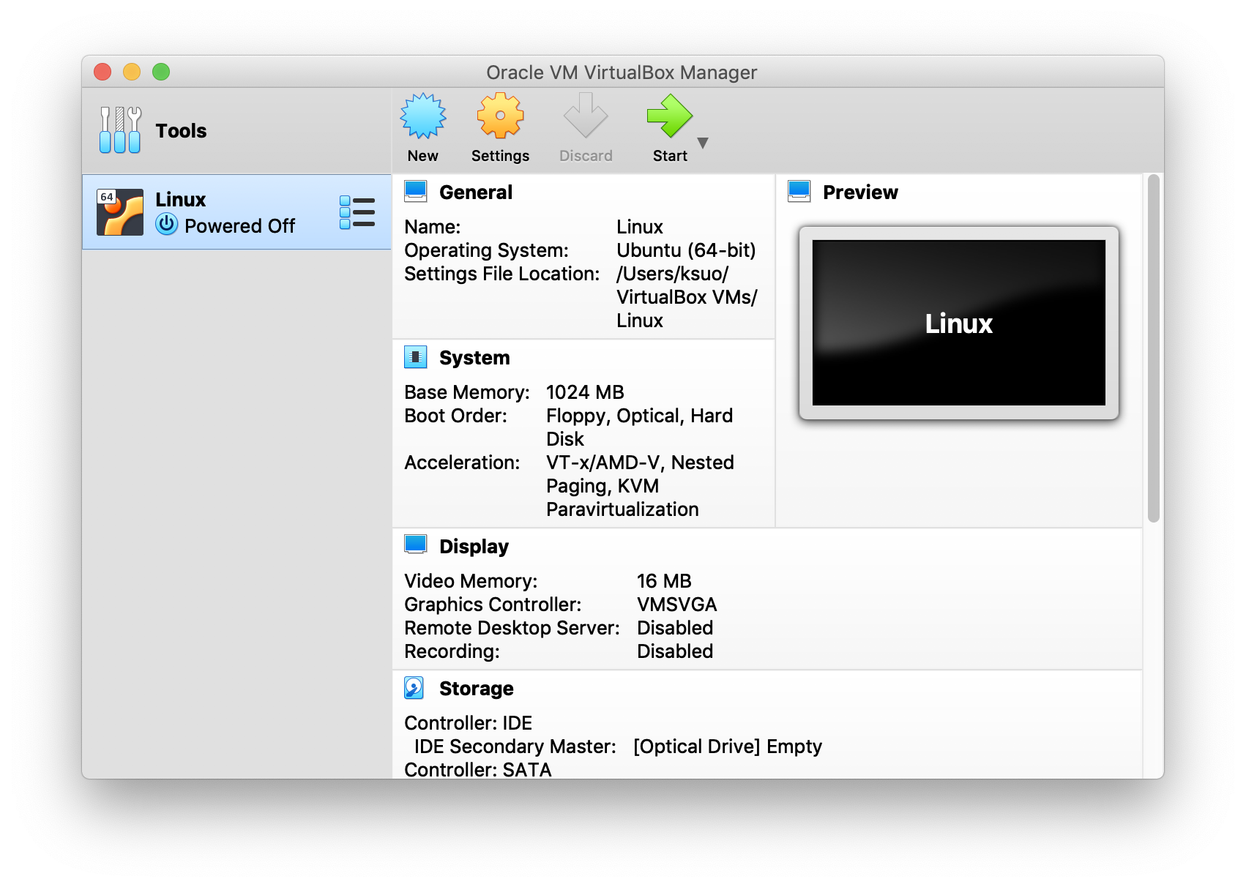
Project Environment
Recommend project environment
VirtualBox + Ubuntu + Linux 5.0
https://cdn.kernel.org/pub/linux/kernel/v5.x/
Virtual machine
VM OS
VM OS Kernel
https://www.virtualbox.org/
https://ubuntu.com/download/desktop

Slide 16
Project Environment
Recommend project environment
VirtualBox + Ubuntu + Linux 5.0
New to VirtualBox?
https://oracle-base.com/articles/vm/virtualbox-creating-a-new-vm
Windows (x86): https://www.youtube.com/watch?v=QbmRXJJKsvs
MacOS (x86):https://www.youtube.com/watch?v=GDoCrfPma2k&t=321s
MacOS (arm):https://youtu.be/O19mv1pe76M?si=4cYayFiqPNoHoY1w
https://cdn.kernel.org/pub/linux/kernel/v5.x/
Virtual machine
VM OS
VM OS Kernel
https://www.virtualbox.org/
https://ubuntu.com/download/desktop

Slide 17
Outline
Introduction & Basics
Why study Operating Systems ?
What to learn ?
Course structure
Course policy
Course goals

Slide 18
Why Study Operating Systems ?
The most complex software
~ 20+ million lines of code in Linux

Slide 19








Why Study Operating Systems ?
The most fundamental software
OSs are almost everywhere, e.g., supercomputer, PC, phone…

Slide 20
Why Study Operating Systems ?
The most complex software
~ 20+ million lines of code in Linux
The most fundamental software
OSs are almost everywhere, e.g., supercomputer, PC, phone…
By studying OS, you will
Learn how computers work
Gain a good understanding of OS with hardware and application
Learn about system design
Simplicity, portability, performance, and trade-offs

Slide 21
What to Learn in OSes?
1. Hardware abstraction
processes, threads, pages, files …

Slide 22
What to Learn in OSes?
2. Resource management
process scheduling, memory management, file systems …
http://www.brendangregg.com/linuxperf.html

Slide 23
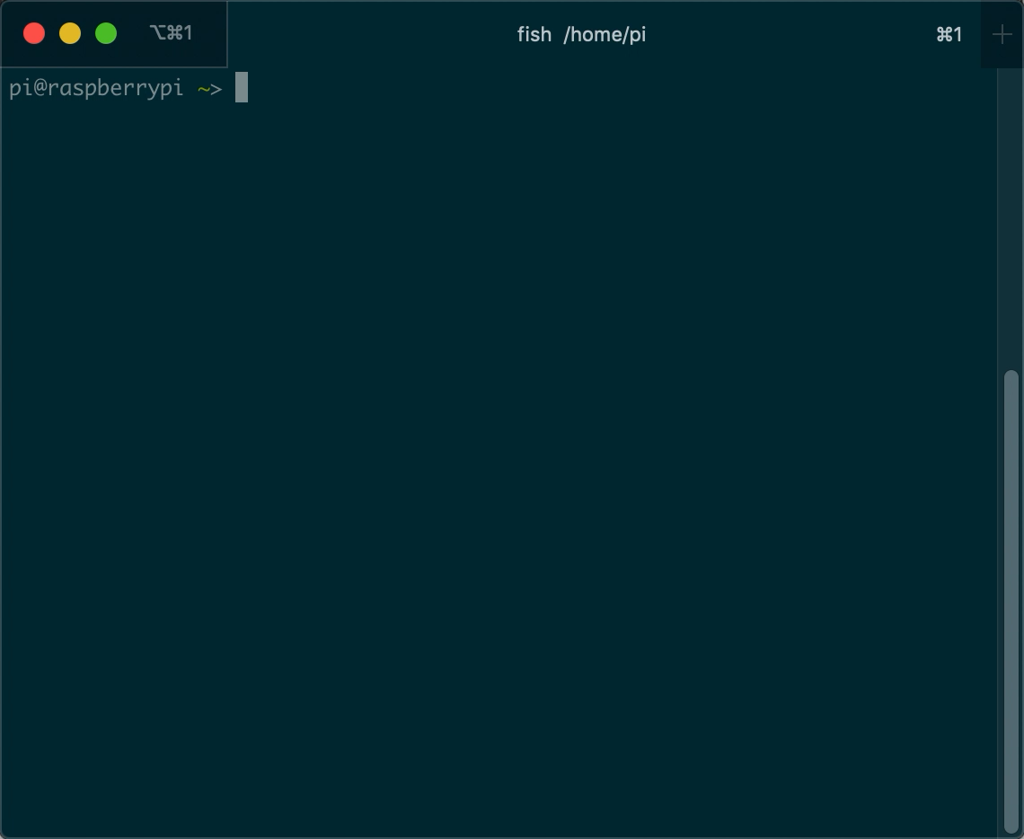
What to Learn in OSes?
2. Resource management
process scheduling, memory management, file systems …
E.g., nmon
http://nmon.sourceforge.net/pmwiki.php

Slide 24
What to Learn in OSes?
3. Coordination
Multiple programs and users
Fairness vs. efficiency
Order
Period
Priority
Preemption
Fairness on different resources
…

Slide 25
What to Learn in OSes?
Hardware abstraction
processes, threads, pages, files …
Resource management
CPU scheduling, memory management, file systems …
Coordination
Multiple programs and users
Fairness and efficiency
Case: Linux
https://elixir.bootlin.com/linux/latest/source

Slide 26
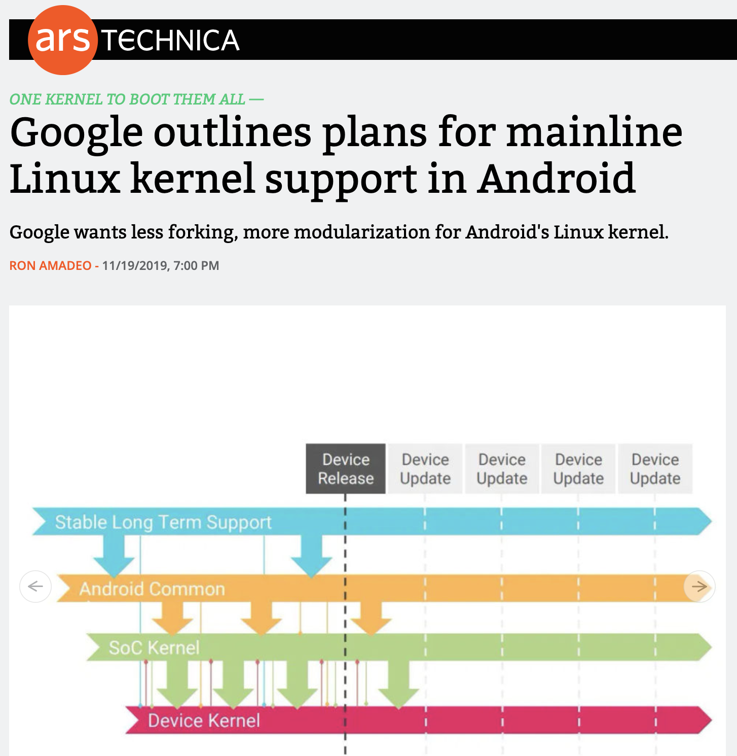

Why Linux? Cloud and mobile.
https://www.cbtnuggets.com/blog/certifications/open-source/why-linux-runs-90-percent-of-the-public-cloud-workload
https://arstechnica.com/gadgets/2019/11/google-outlines-plans-for-mainline-linux-kernel-support-in-android/

Slide 27
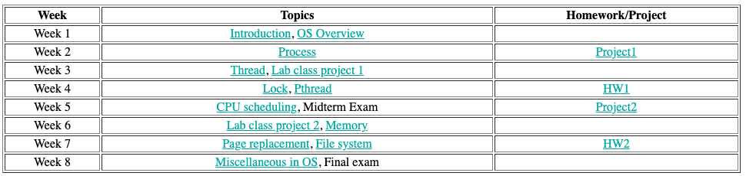
What to Learn ?
http://pages.cs.wisc.edu/~remzi/OSTEP/

Slide 28
Course Structure
Lectures
3502/W01: D2L online
Homework
2 written assignments
Projects
2 programming assignments (platform Linux 5.0+)
Exams (open books, open notes)
Midterm: D2L
Final: D2L

Slide 29
Course Policy
Grading scale
Percentage | Grade
90 - 100 | A
80 - 89 | B
70 - 79 | C
60 - 69 | D
Below 60 | F

Slide 30
Grading Policy (cont.)
Grading percentage
In-class discussion and attendance: 5%
Homework assignments (x2): 10%
Projects (x2): 35%
Midterm: 20%
Final exam: 30%
Late submission policy: late submission will not be accepted and no credits

Slide 31
Academic Integrity
Academic dishonesty
Cheating
Plagiarism
Collusion
The submission for credit of any work or materials that are attributable in whole or in part to another person
Taking an examination for another person
Any act designed to give unfair advantage to a student or the attempt to commit

Slide 32
Where to go for help ?
Ask questions in class
Ask questions outside class
Classmates and friends
Attend office hours
Dr. Kun Suo: Tuesday/Thursday 3:00PM – 4:00PM, J-318
Search on the web
Stand on the shoulder of giants

Slide 33
Fundamental Goals
Learning the concepts in OSes
Attend class on time
Ask questions if you have
Review the slides and learn from the internet
Working homework by your own

Slide 34
Fundamental Goals
2. Learning how to program with OS
Be able to design and implement well-structured system software, e.g., system calls
Learn how to use OS abstractions, e.g., process, thread, pages, files, …
Master how to use resources in OS, e.g., CPU, memory, disk, …
Learn how to debug and solve problems

Slide 35
Conclusion
Why study Operating Systems ?
The most complex software
The most fundamental software
What to learn ?
Hardware abstraction
Resource management
Coordination
Course structure
Course policy
Course goals
Learning the concepts
Learning how to program with OS

